Slide 1



THE AQUANTIS OCEAN-CURRENT TURBINE
RENEWABLE ENERGY FROM MARINE CURRENTS
Turbine Blade Attachment Notes
Dave Dreese, ARL Penn State
Dennis Wess, ARL Penn State
February 13, 2012
Company Confidential and Proprietary

Slide 2
Pass Through Spar Concept
Objective: Reduce the cost and weight of the blades and the rotor hub
Pass Through Spar Concept:
  Potential to dramatically reduce cost and weight
  Initial geometry development of a blade design with a through-the-hub spar
  Concurrent work with the preliminary hydrodynamic analysis of a turbine with a hydrodynamically-optimum shaft rate and a 1,000 kW rated power out of the generator
Updated loads and FOS
  Potential to dramatically reduce cost and weight
  Extraction of loads at 1.6 m/sec rather than at 2.0 m/sec
  New cost-effective material (e-glass composite, metal, or hybrid)
    Removal of carbon-composite material

Slide 3
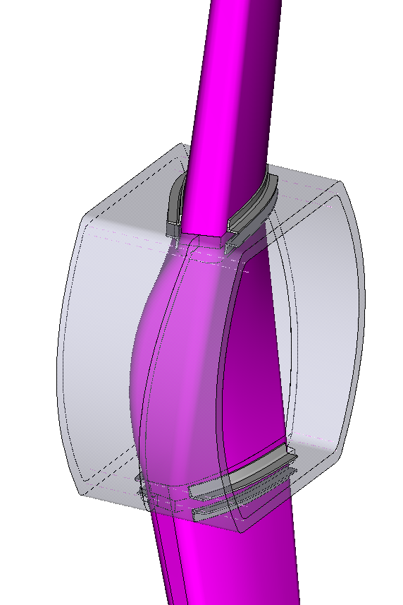
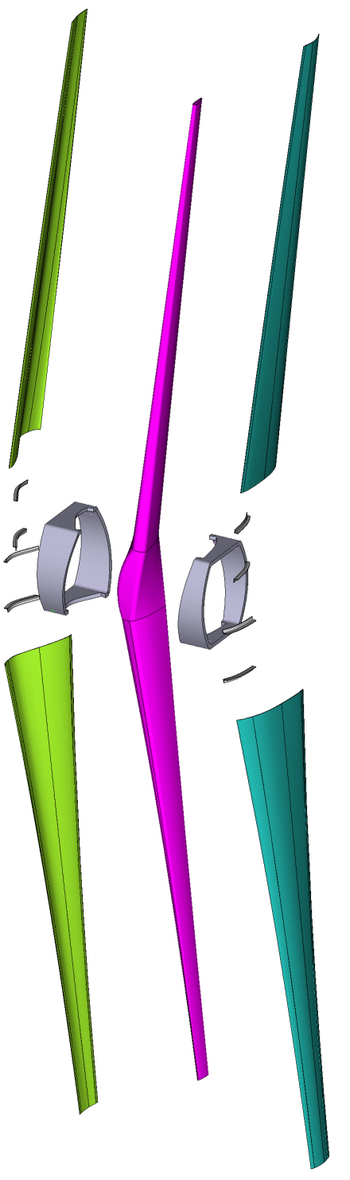
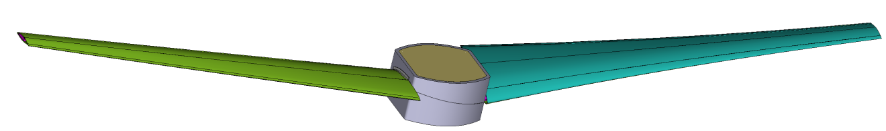
Pass-through Spar Concept Geometry
Spar
Foam-filled split hub
Syntactic foam
Spar clamps
Blade outer shells (fairings)

Slide 4
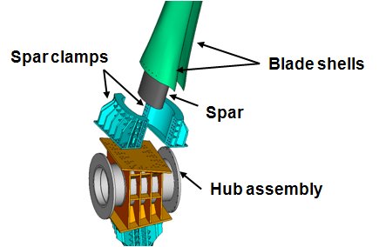
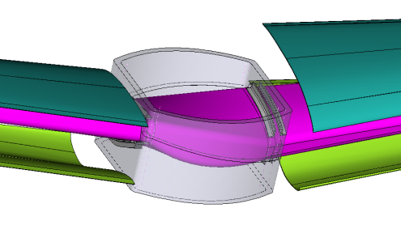
Updated Preliminary Turbine Design
PDR Concept
Pass-through spar Concept
Hub
Spar
Spar clamps
Blade shells
Component | Dry Weight (kg) |  | Wet Weight (kg) |  | Cost
 | PDR | Pass-thru | PDR | Pass-thru | PDR | Pass- thru
Composite Spar(s) | 12,340 | 23,640 | 4,440 | 11,790 | $1,170,000 | $735,000
Syntactic Foam | 8,000 | 13,140 | -5,900 | -21,190 | $92,000 | 151,000
E-Glass Composite Skin | 6,700 | 9,200 | 3,260 | 4,590 | $344,000 | $330,000
Steel Spar Clamps | 48,000 | 2,600 | 40,800 | 2,260 | $610,000 | $17,000
Hub Assembly | 70,700 | 27,600 | 61,400 | 24,000 | $806,000 | $183,000
Total | 145,740 | 76,180 | 104,000 | 21,450 | $3,022,000 | $1,416,000

Slide 5
Blade FEM Details
Load Nodes at ¼ chord
Attached to spar with rigid elements
41.5m diameter
7° rake
139,000 Elements
450,000 DOF

Slide 6
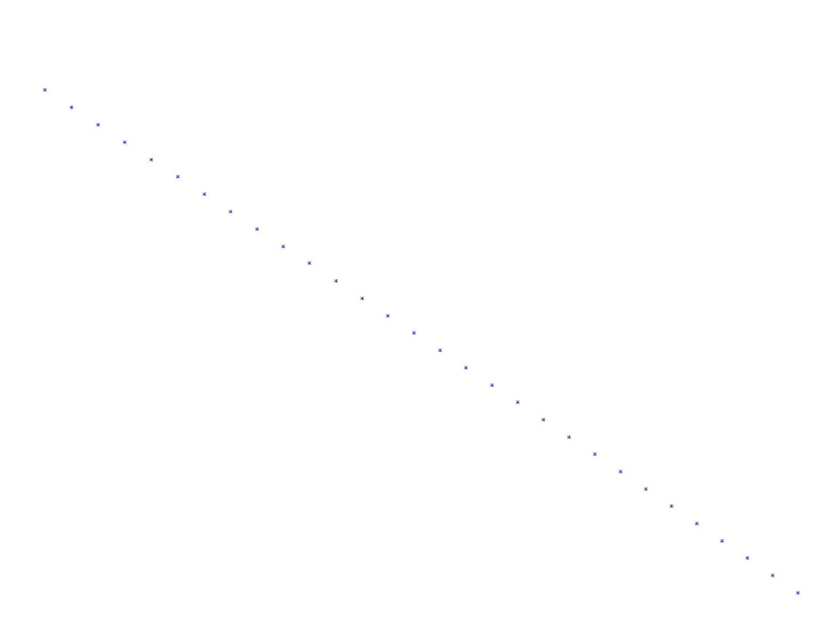
Blade FEM Details
Load Nodes at ¼ chord
Attached to spar with rigid elements
Full Beam Mesh: 41.5m Diameter
Single Blade
Model generated in sections:
Blades and Hub generated and merged to allow for iterations of hub and attachment geometries while maintaining hydrodynamic blade shape
Matched mesh definition for combining blades and center spar
Central Spar Section
139,000 Elements
450,000 DOF
Applied Loads and Moments
1.6 m/s load case applied at ¼ chord

Slide 7
Blade FEM Details
Full Blades with skins – 41.5m
2. Full Spar with no skins – 41.5m
3. Truncated Spar with no skins - 8.5m
Full Blade with Skins – distributed load
Full Blade w/o Skins – distributed load
Spar Stub w/o Skins – point load

Slide 8
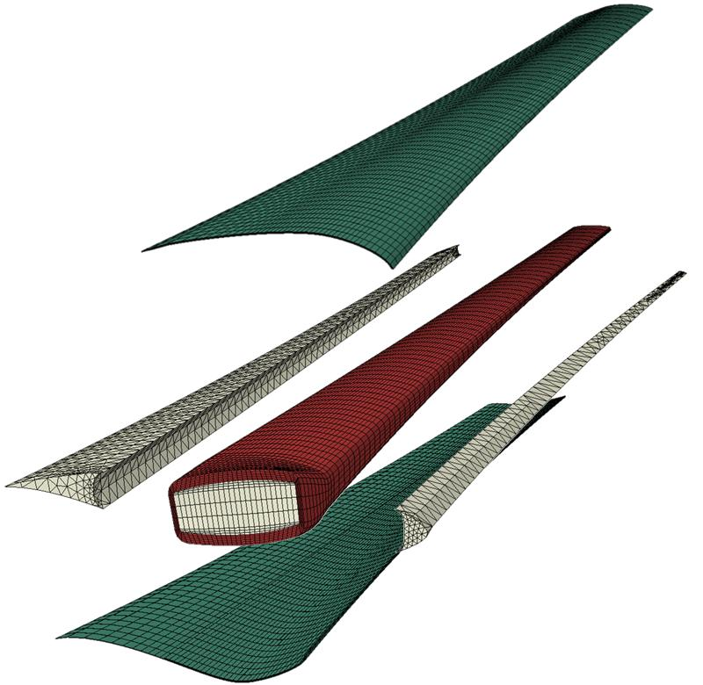

Blade FEM Details
Blade Assembly:
Hub built around center foam mold
Le and TE foam applied
PS and SS skins attached
Blades attached to central spar section
Assembly installed in hub
Spar webs half the thickness of spar caps
Spar cap max thickness 6 in at root
Center Foam Mold
Attachments Fixed Along Upright
Suction Surface (SS) E-Glass Composite Skin
Leading-Edge (LE) Foam
Trailing-Edge (TE) Foam
Tied Contact at Attachment/Spar Interface
Pressure Surface (PS) E-Glass Composite Skin
139,000 Elements
450,000 DOF
E-Glass Composite Spar
Applied Loads:
Thrust = 151,655 lb
Torque = 22,739 lb

Slide 9
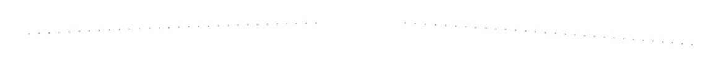
Full Blade Assembly to Local FEM Methodology
Full Blades – loads applied at discrete locations along ¼ chord line
Attachments fixed along upright
Spar webs half the thickness of spar caps
Spar cap max thickness 6 in at root
Tied contact at attachment/blade spar interface
Applied Loads:
Fx = 151,655 lb
Fy = 22,739 lb
Spar Sections – summed loads and moments applied at end of spar
Load point attached to spar with rigid elements

Slide 10
Material Properties

Slide 11
Blade Analysis Results – Margin of Safety
Margin of Safety = FOS -1

Slide 12
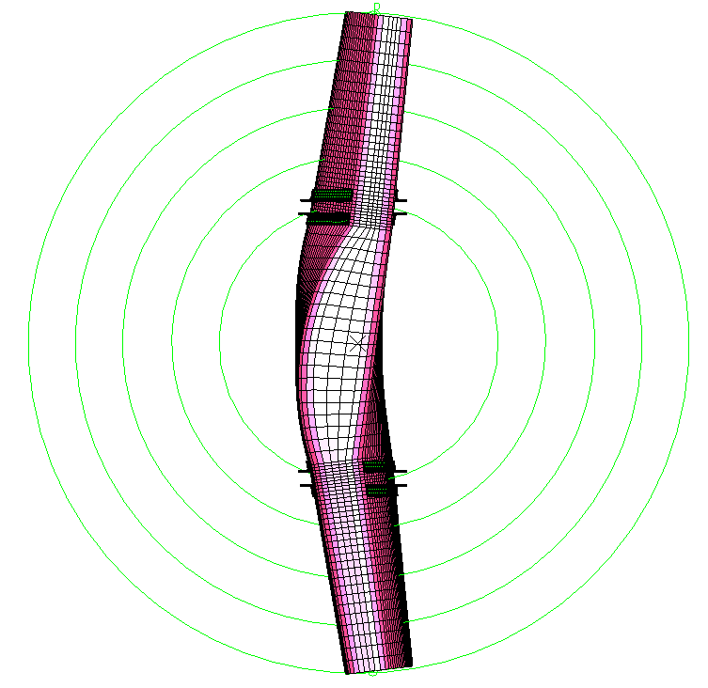
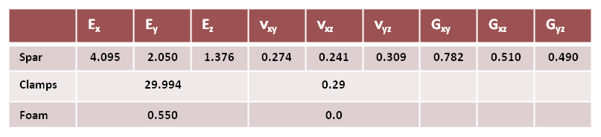
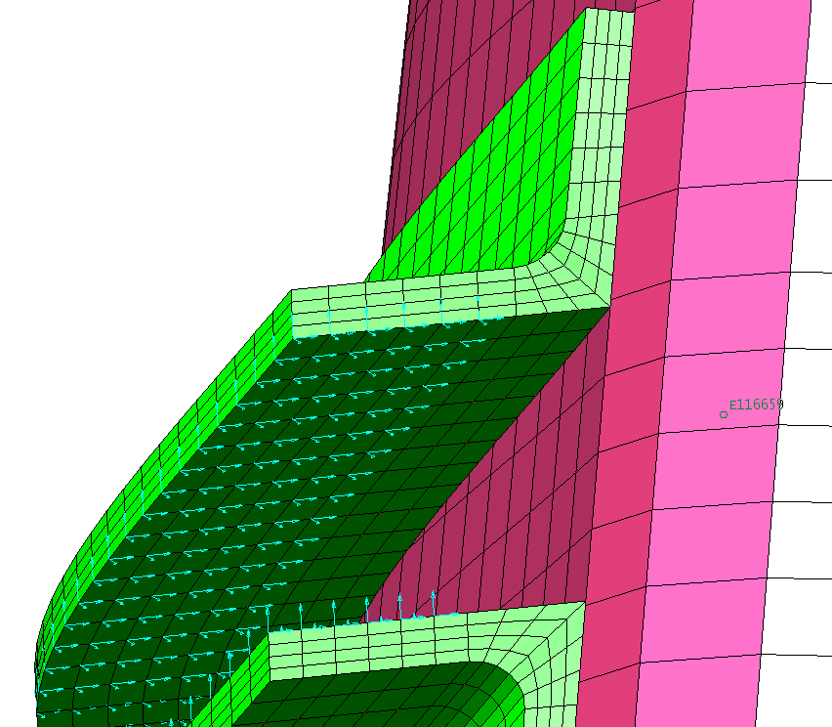
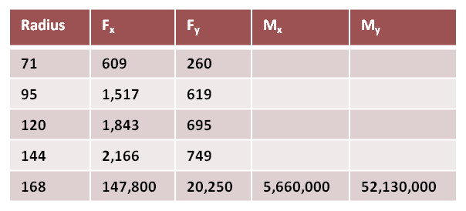
Spar Analysis
168 R
144 R
Truncated spar used in the analysis
  Max radius = 168 inches
  Dual steel clamps applied at 72R
    1 inch thick, 6 inch legs
Spar filled with foam
“Tailored” laminate material properties (moduli in msi):
Restraints applied to clamps
  Extend about ¾ across hub mounting flange
Clamps tied to spar using constraint elements (Ideas) or tied contact (Abaqus)
Loads:
  See chart (in, lb units)
  Forces and moments at 168R applied to rigid element near ¼ chord
  Forces at smaller radii applied to a group of nodes on loaded side of spar
120 R
95 R
71 R
“Partial” restraints – don’t extend to edge

Slide 13
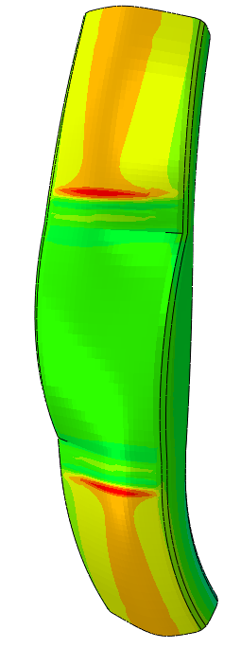
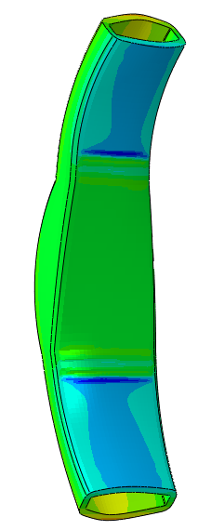
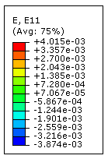
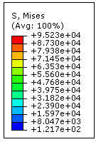
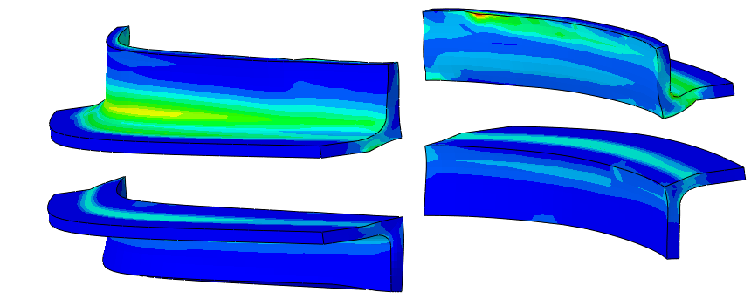
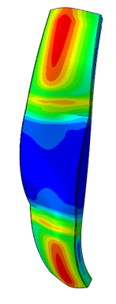
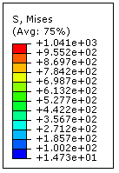
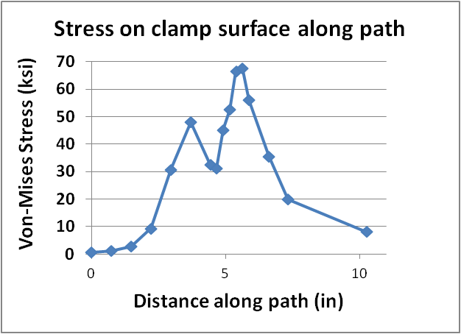
Results from Abaqus – Partial Restraints on Clamps
SPAR
  Strain in span-wise (0°) direction shown for spar
  Maximum strain at joint
    Max. tensile: 0.00402
    Max compressive: -0.00387
  Strains at joint OK!
CLAMPS
  Outboard clamps hogging most of the load
    Stress spikes due to tied contact and point-wise restraints
  Max. stress in fillet shown in chart
FOAM
  Maximum Von-Mises stress: 1.04 ksi
Path for plot
Foam

Slide 14
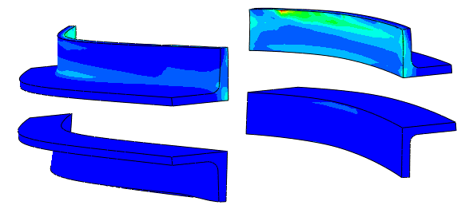
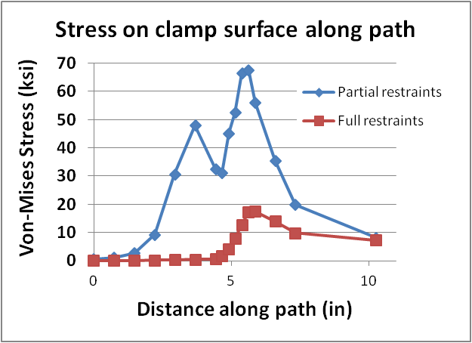
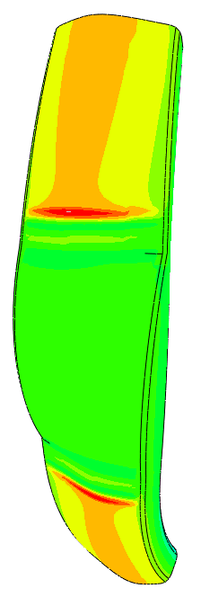
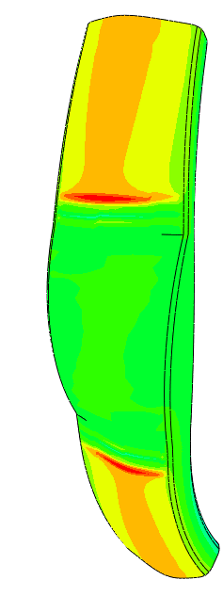
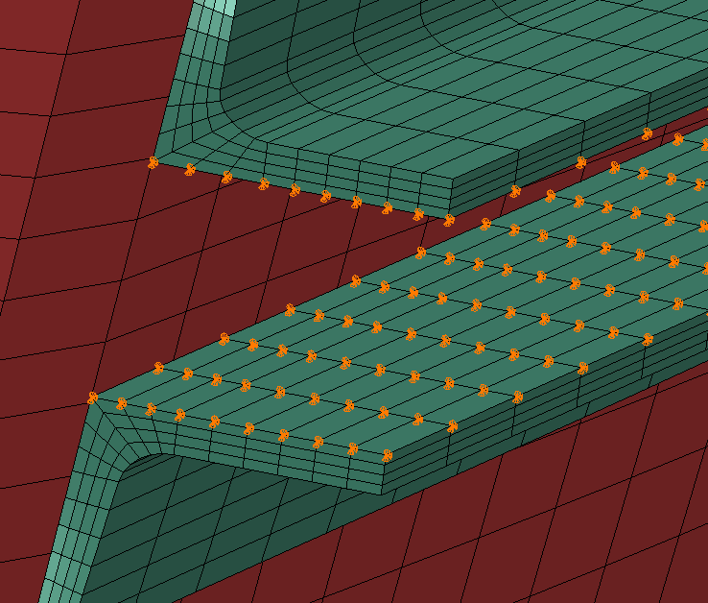
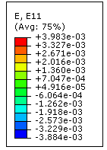
Re-run of Abaqus Model: Clamps Fully Restrained
With clamps fully restrained, stresses lowered in the clamp fillet
  See chart
Span-wise strains in spar fairly constant
Path for plot
Partial restraints
Full restraints
“Full” restraints –extend to edge of clamp
Partial restraints
Full restraints

Slide 15
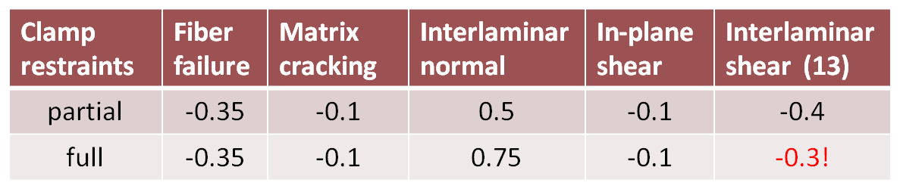
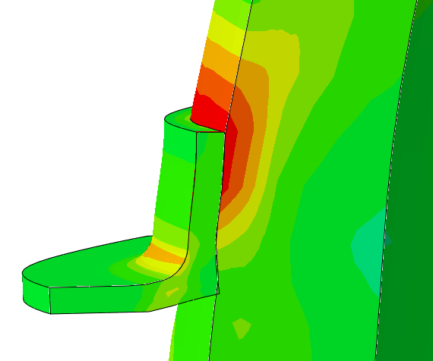

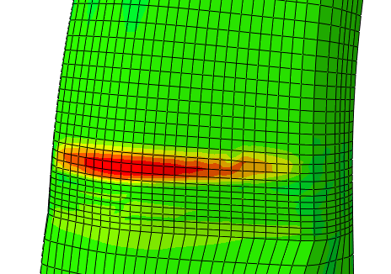
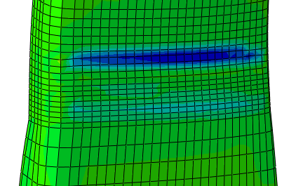
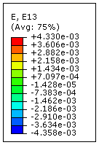
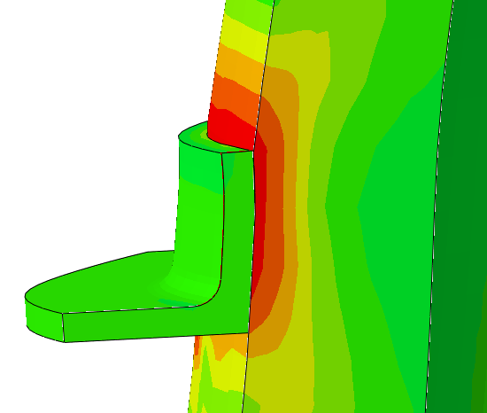
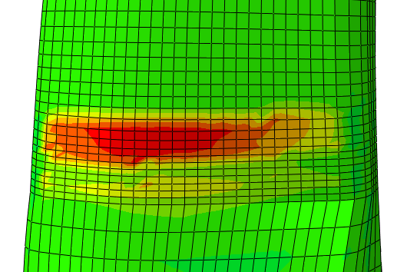
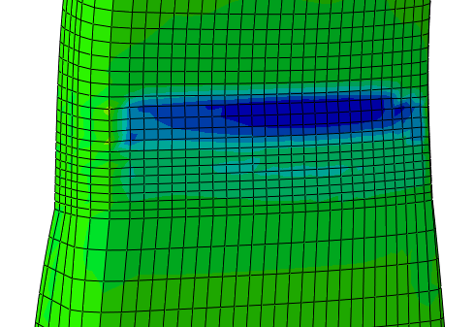
Re-run of Abaqus Model: Clamps Fully Restrained (Cont.)
Comparison of FSS values for spar
  Partial restraints
    Z reaction forces:
      Front: -1,505 kips
      Rear: -1,610 kips
    Full restraints
      Front: -1,941 kips
      Rear: -1,994 kips
Laminate Margins of Safety
Partial restraints, E13
Partial restraints, E13 (interlaminar shear)
Smaller E13 strains for full restraints since affected region is larger (due to lower distortion of the clamp)
Full restraints, E13
Full restraints, E13 (interlaminar shear)

Slide 16
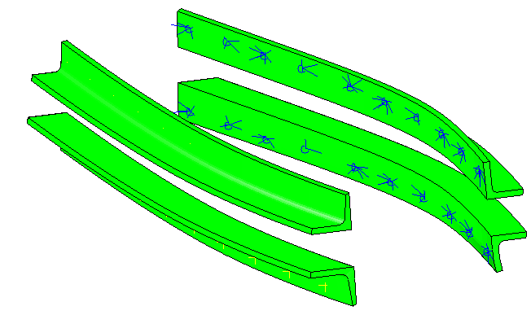
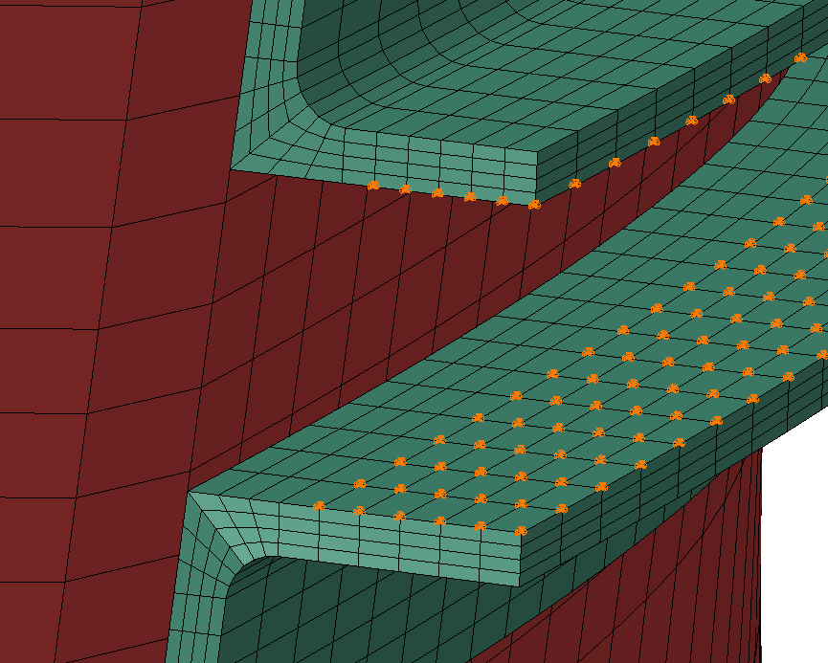
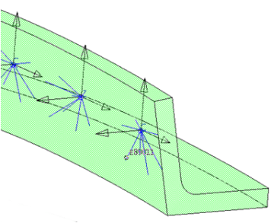
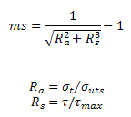
Simulation of Mounting Screws
10 Attachment Points in Each Clamp
Material orientations assigned to clamp elements for post-processing constraint forces
  X is normal to element contact face (screw axial load)
  Y is along clamp surface (screw shear load)
  Z is vertical (screw shear load)
Constraint forces determined for different restraint conditions on the clamps
  A) clamps partially restrained
  B) clamps fully restrained
  C) constraint nodes grounded
Margins of safety determined based on 3 inch diameter grade 2 screws
  Tensile ultimate: 60 ksi
  Shear ultimate (62% of UTS): 37 ksi
  BOLT BENDING NOT ACOUNTED FOR
  Margin of safety due to tension and shear:
Z
Upper front
Upper rear
Y
X
Lower front
Lower rear
Clamp mounting flange boundary condition
Grounded constraint elements
Partial
Full

Slide 17
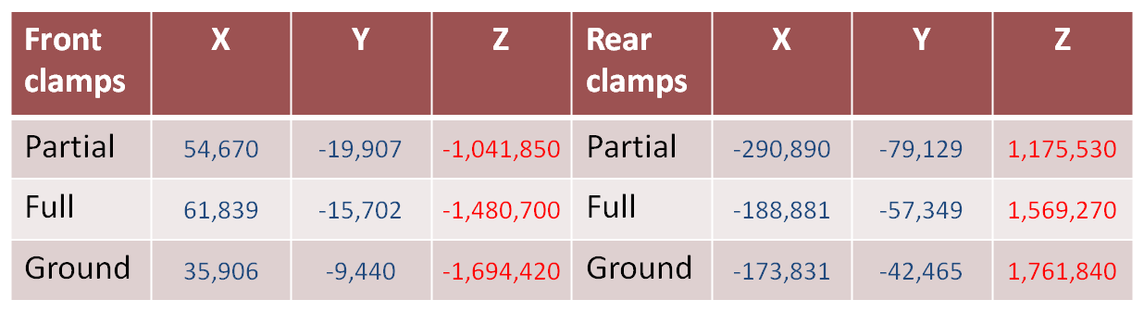

Summary of Forces and Screw M.S. Values
Summary of resultant forces for a pair of clamps
Margin of Safety values – different boundary conditions
Z
Upper front
Y
Upper rear
X
Lower front
Lower rear
Clamp mounting flange boundary condition
Grounded constraint elements
Partial
Full

Slide 18
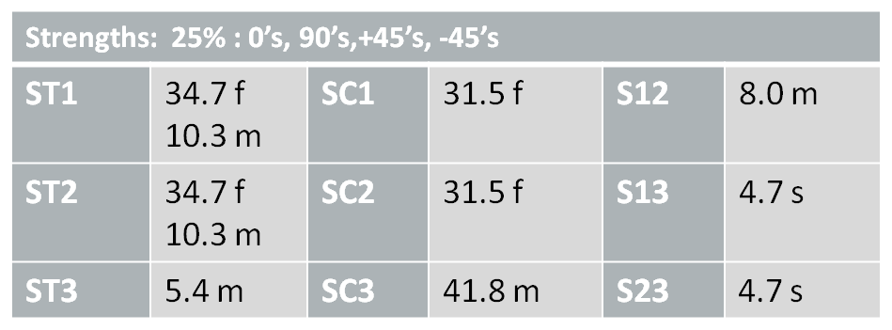
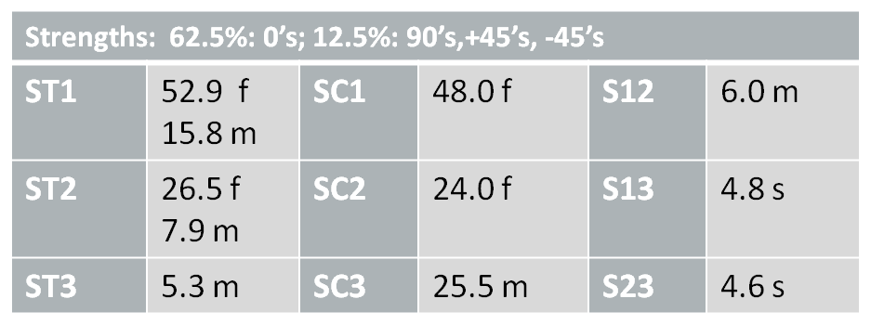
Estimated Laminate Strengths
Lamina strengths
    S11(+) = 7.10960D+04 S11(-) = 6.44060D+04 S12 = 9.17000D+03
    S22(+) = 5.04000D+03 S22(-) = 5.25000D+04 S13 = 4.85800D+03
    S33(+) = 5.04000D+03 S33(-) = 5.25000D+04 S23 = 4.85800D+03
Laminate configurations
  Quasi-isotropic (0’s: 25%, 90’s: 25%, +45’s: 25%, -45’s: 25%)
  Tailored laminate (0’s: 62.5%, 90’s: 12.5%, +45’s: 12.5%, -45’s: 12.5%)
Laminate strengths:
Quasi-isotropic
Tailored
(f: fiber, m: matrix, s: shear)

Slide 19




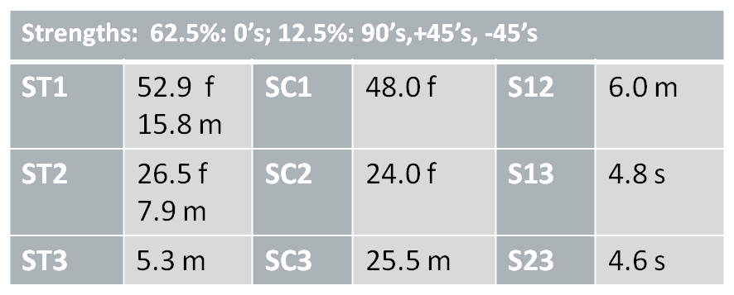
Preliminary Composite Analysis for Simulated Screws In Clamps
Check composite bolted joint
  1) Bearing stress
  2) Net-tension
  3) Wedge-type splitting
  4) Shear-out
  5) Tension with shear-out
Assumptions:
  One clamp each side of spar
  Ten 3 inch diameter bolts each clamp
  Total shear load equals 2,000 kips: 200 kips/bolt
  6 inch thick composite
  Bolt spacing at 2.5D (7.5 inches)
  Edge distance = 12 inches
  Composite strengths - based on 62.5% 0’s:
2 3 4 5
Calculations:
  1) Bearing stress
    σ = F/td = 200/6(3) = 11.1 ksi
    SC1 = 48 ksi M.S. = (48/11.1/4)-1 = 0.1
  2) Net-tension
    σ = F/(w-d)t = 200/(7.5-3)6 = 7.4 ksi
    ST1 = 53 ksi M.S. = (53/7.4/4)-1 = 0.8
  3) Wedge-type splitting
  σ = 2F/(2e-d)t = 2(200)/(2(12)-3)6 = 3.2 ksi
  SC2 = 24 ksi M.S. = (24/3.2/4)-1 = 0.9
  4) Shear-out
  σ = F/2et = 200/2(12)6 = 1.4 ksi
  SC2 = 24 ksi M.S. = (24/1.4/4)-1 = 3.2
  5) Tension with shear-out
  F = t[(w-d)ST1 +2eS12]/2
  = 6[(4.5)53 + 2(12)6.0]/2 = 1,148 kips
  M.S. = (1,148/200/4)-1 = 0.4

Slide 20
Summary
Pass-through spar design is feasible
  Preliminary calculations indicate positive margins of safety for the composite laminate and the screws at the joints
Wet weight savings of 83,000 kg compared to PDR concept
Cost savings of $1.6M compared to PDR concept

Slide 21
Bolt-on spar analyses
Bolt on Spar Attachment Analysis
Barrel Nut/Bonded Insert

Slide 22
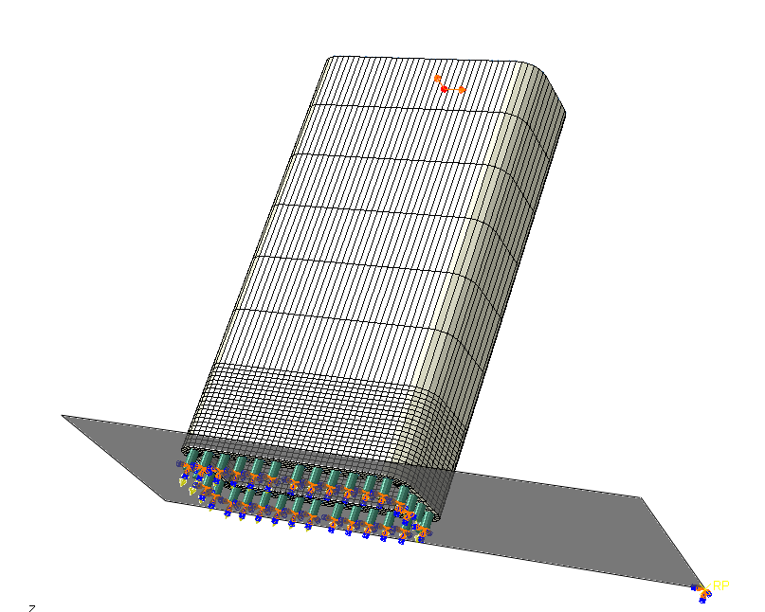
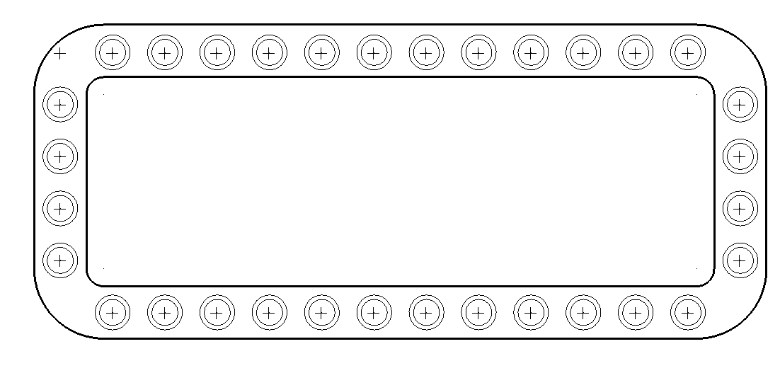
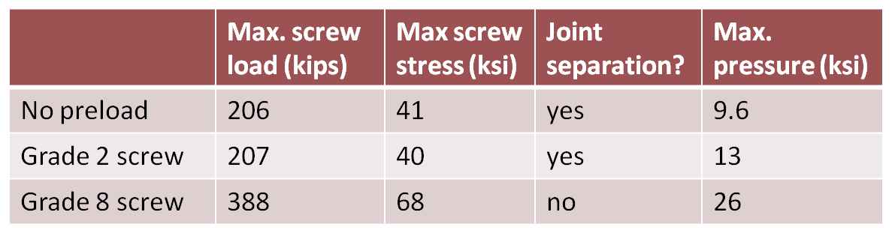
Bolt-on spar analysis (1.6 m/s loads)
Global model developed
  Rectangular spar section: 7 ft. by 3 ft. X 6 inch wall
  Uses 32 three inch diameter inserts (screws)
Loads on spar based on a flange located at a radius of 3.5 ft
  Loads corresponding to flow velocity of 1.6 m/s applied to end of 150 inch spar:
    Axial force: 147,200 lbs, moment: 48,000,000 in-lbs
    Transverse force: 10,760 lbs, moment: 3,200,000 in-lbs
Determined maximum screw tensile load and contact pressure. Determined if joint separates
  No preload
  Preload for grade 2 screw
  Preload for grade 8 screw
Loads applied at end of spar
Glass/epoxy spar
Fixed rigid surface
Contact between spar and rigid surface
“screws” with restraints on end

Slide 23
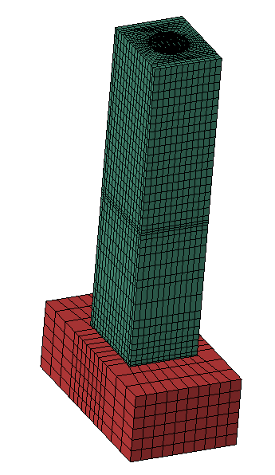
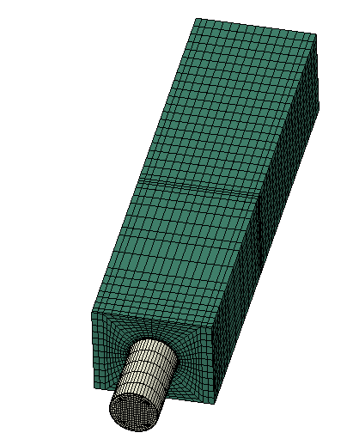
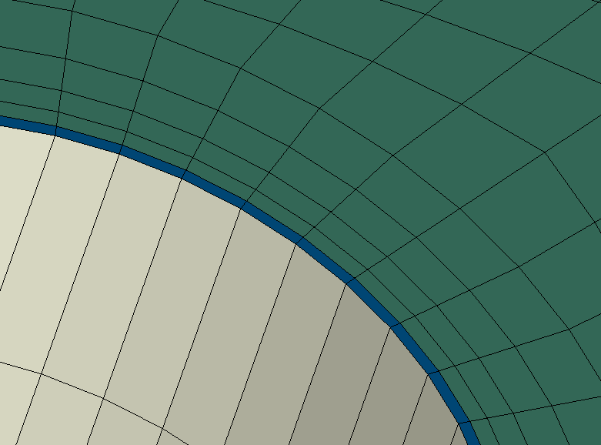
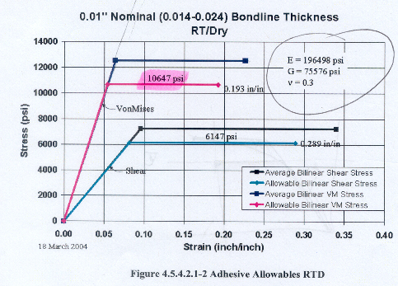
Sub model setup – bonded insert
Sub model developed for a section of the spar with a single screw
  Includes a metal insert and mounting plate, adhesive layer, and glass composite spar section
Displacement restraints applied to top of model based on displacements from global model
  Based on 1.6 m/s loads
  Highest loaded screw in tension
Six cases considered:
  No flange on insert
    no preload
    preload based on grade 2 screw
    preload based on grade 8 screw
  Flange on insert
    preload based on grade 8 screw
    preload based on grade 8 screw, reduced adhesive at top
    preload based on grade 8 screw, reduced adhesive at top and bottom
Material properties used in the model
  Glass:
    Uni glass properties
      Wet, b-basis: E11 = 5.5 MSI, E22/E33 = 1.31 MSI,
      S11+ = 71.1 ksi, S11- = 64.4 ksi, S22+/S33+ = 5.0 ksi, S22-/S33- = 52.5 ksi
    Smeared quasi properties
      E11/E22 = 2.69 MSI, E33 = 1.4 MSI, Gxy = 1.0 MSI, Gxz/Gyz = 0.5 MSI
  Adhesive: elastic/perfectly plastic bilinear curve
    E: 190 ksi, nu = 0.3
    Allowable Mises stress: 10.6 ksi, failure strain: 0.193
  Steel
    E: 30,000 ksi, nu = 0.29
Metal insert
Adhesive layer (0.04 thk)
Adhesive stress/strain curve

Slide 24
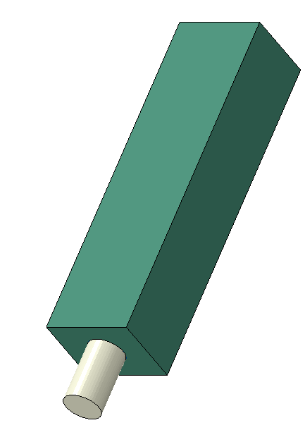









Sub models: Flanged and Un-flanged
Flanged insert greatly reduces high stresses on spar and adhesive due to screw preload
Adhesive
Adhesive
Un-flanged insert
Flanged insert

Slide 25


Barrel nut sub model
Spar section with displacements applied based on global model results
Steel barrel nut, screw, and base
Contact defined for barrel nut/spar interaction and spar/base interaction
Preload applied to screw in first load step
  Grade 2 and grade 8
Spar displacements applied in second load step

Slide 26

Sub model results – 1.6 m/sec
Bonded steel insert/stud
  Large tensile load on insert produced by bending moments on spar
  High screw preloads required to prevent spar from lifting off of mounting surface
  High screw preloads produce high stresses (and strains) in adhesive for un-flanged cases
    Adhesive fracture predicted
  Flange on insert prevents the preload reaction from significantly impacting the adhesive or composite
  For flanged cases, stress in adhesive is over 5 ksi during spar load application
    Margin of safety of less than 1 on adhesive failure
  Flanged insert results sensitive to adhesive placement
    Removal of top surface adhesive increases adhesive maximum stress by over 60% and cuts composite margins of safety in half
    Removal of adhesive near bottom promotes a prying action on spar composite material
Barrel nut
  High preload required to prevent lift-off of spar
    350,000 pounds for 3 inch grade 8 screw
  Screws experience some bending since they are completely restrained at the lower end (head of screw)
  Composite material highly loaded under barrel nut
    Composite fatigue margins of safety not sufficient for 20 year life
      Strengths based on a typical glass/epoxy quasi layup
Neither case produced an acceptable design for 1.6 m/s loads
Flange on insert
Adhesive on all surfaces
No adhesive on top surface
No adhesive on top or bottom surfaces

Slide 27
Sub model results – 1.6 m/sec
Component | no preload |  | grade 2 |  | grade 8
 | step 1 | step 2 | step 1 | step 2 | No flange |  | Flange |  | Flange – no top adhesive |  | Flange – no top/bottom adhesive
 |  |  |  |  | step 1 | step 2 | step 1 | step 2 | step 1 | step 2 | step 1 | step 2
insert, resultant force (kips) | 0 | 115 | 100 | 161 | 350 | 415 | 350 | 382 | 350 | 380 | 350 | 382
insert, resultant moment (kin-lbs) | 0 | 35 | 0 | 25 | 0 | 16.3 | 0 | 0.5 | 0 | 0.5 | 0 | 1
insert, Mises stress (ksi) | 0 | 31.1 | 18.3 | 33.9 | 53.4 | 68.8 | 60.4 | 65.0 | 60.4 | 64.8 | 61.1 | 65.2
adhesive, Mises stress (ksi) | 0 | 4.0 | 10.8 | 10.7 | 10.7 | 10.4 | 2.8 | 5.2 | 2.8 | 8.5 | 2.1 | 8.7
adhesive, max princ strain | 0 | 0.023 | 0.054 | 0.052 | 0.387 | 0.381 | 0.016 | 0.033 | 0.016 | 0.029 | 0.009 | 0.030
percent area in contact |  | 5% |  | 40% |  | 100% |  | 65% |  | 65% |  | 10%
Composite fatigue margins of safety – quasi glass
fiber failure | -- | -0.6 | -0.1 | -0.6 | -0.8 | -0.7 | 2.5 | 0.9 | 2.5 | -0.3 | 4.6 | -0.3
matrix cracking | -- | -0.8 | -0.2 | -0.8 | -0.6 | -0.8 | 1.4 | 0.0 | 1.4 | -0.6 | 2.4 | -0.6
interlam normal | -- | -0.4 | -0.6 | -0.7 | -0.8 | -0.8 | 1.3 | 0.5 | 1.3 | 0.6 | 1.5 | 0.3
in-plane shear | -- | -0.6 | -0.4 | -0.6 | -0.7 | -0.7 | 3.3 | 1.2 | 3.3 | -0.2 | 4.0 | -0.2
transverse shear | -- | -0.6 | -0.2 | -0.6 | -0.6 | -0.7 | 0.4 | -0.3 | 0.4 | -0.6 | 0.5 | -0.6
  Step 1 is screw preload only, step 2 adds spar load
For underlined values, hot spot is at top of adhesive

Slide 28


Barrel Nut sub model results (1.6 m/s)
Component | grade 2 |  | grade 8
 | step 1 | step 2 | step 1 | step 2
insert, resultant force (kips) | 100 | 223 | 350 | 394
insert, resultant moment (kin-lbs) | 0 | 22 | 0 | 10
insert, Mises stress (ksi) | 14.4 | 55.3 | 66.0 | 83.2
percent area in contact |  | 0% |  | 80%
Composite fatigue margins of safety – quasi glass
fiber failure | 0.1 | -0.5 | -0.7 | -0.7
matrix cracking | -0.1 | -0.6 | -0.7 | -0.8
interlam normal | 0.5 | -0.1 | -0.5 | -0.5
in-plane shear | 0.0 | -0.6 | -0.7 | -0.8
transverse shear | 1.2 | -0.2 | -0.4 | -0.5
Used preloads for grade 2 and grade 8 screws
Screws experience some bending since they are completely restrained at the lower end
Composite lifts slightly from base even for grade 8 preload

Slide 29
Summary
Bonded-in inserts
  High screw preloads required to prevent lift-off of spar from base
  Flanged insert required to reduce stresses on laminate and adhesive due to high screw preload forces
  With “perfect” adhesive joint, laminate fatigue margins of safety less than zero for transverse shear failure mode
    Adhesive margin of safety less than one
    Typical adhesive joints will exhibit multiple laminate failure modes
Barrel nuts
  High screw preloads required to prevent lift-off of spar from base
  Margins of safety less than zero for all laminate fatigue failure modes

Slide 30
Previous Material
The following were slides previously sent to Ecomerit

Slide 31





Spud Concept: Initial Assessment
Simple model developed to assess feasibility
  Constant cross-section spar that passes straight through hub
  All materials steel
  Perfect line to line fit of spar in the ring slot
  Contact between the spar and ring
  Spar prevented from radial displacement
6 in
3 ft
7 ft
Pass-thru spar size
5 in
12.5 ft
Elliptical spar cross-section from PDR for comparison
Ring size

Slide 32




Spud Concept: Initial Results
(Deflection scaled 100X)
Load case 1:
  Using thrust and resulting moment from PDR (2 m/s loads)
  Equal for both ends of spar (balanced loads)
  Stresses ~10 ksi
Load case 2:
  Loading of one end only (worst case)
  Reaction force increase of 4.7 at ring
  Max. stresses ~ 47 ksi
(Deflection scaled 100X)

Slide 33






Spud Concept: Initial Results
X
Axial displacement of spar
X
equally loaded spar
one side only
(Deflection scaled 100X)
+0.025 inch
+0.08 inch
-0.025 inch

Slide 34



Spud Concept: Initial Results (E-Glass)
Fiber Failure
Symmetry Model for Thrust-Only Loading
Failure Mode | Thrust Only | Thrust and Torque
Fiber Failure | 3.5 | 3.4
Matrix Cracking | 1.2 | 1.2
Interlam. Normal | 2.9 | 2.8
In-Plane Shear | 4.0 | 3.9
Interlam. Shear | 3.9 | 2.8
Fiber Failure
Full Model for Thrust-and-Torque Loading

Slide 35
Spud Concept: Path Forward
Implement e-glass properties for spar
  Quasi
  Enhanced with uni’s
Use loads at 1.6 m/s (rather than at 2.0 m/s)
Add torque loading
Reduce section thicknesses to produce FOS of 2.0 (rather than 3.0)
  25 ksi for 50 ksi yield steel
  Weight reduction
Estimate weights for ring, ring clamp, spar and hardware
Assess impact of re-pitched blade
Concept Feasibility Shows Promise with Simple Analysis

Slide 36


Wind-Turbine-Blade Joint Feasibility
Wind industry typically uses either metal studs or inserts in end of spar for root attachment
  Have also seen some use of “barrel” nuts which are installed transversely
As a general rule, we avoid end–installed studs or inserts when attaching composite components due to the “pry bar” effect

Slide 37
Wind-Turbine-Blade Joint Feasibility
Due to large spar planforms currently being considered at the root (7 ft x 3 ft x 6 inches thick), preliminary analysis indicates that the concept can not be dismissed
However,
  Screw spacing is tight (much less than desired the 3 diameters in composite material)
  Distance from edge-of-the-hole to the part edge is very tight due to large diameter screws/inserts
  Adhesive shear stress goes way down if any bending of the bonded components is present
  A lot of composite material is removed for the large screws
Therefore, we recommend that some detailed sub-models be developed to determine the feasibility, especially for a barrel-nut solution

